Slide 1
Big Data Hadoop Implementations
By Kurt Westerman

Slide 2
Defining Big Data
Volume
Velocity
Variety

Slide 3
ACID v. BASE
Relational
Atomicity
Consistency
Isolation
Durability
NoSQL
Basically
Available
Soft state
Eventual Consistency

Slide 4
CAP Theorem
Consistency
Availability
Partition tolerance

Slide 5
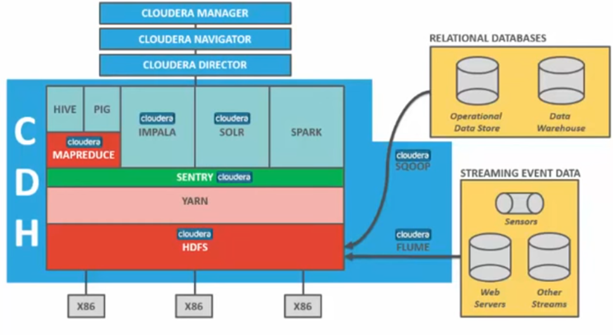
Cloudera CDH package for Hadoop

Slide 6
Strengths and Weaknesses
Consistency
Partition tolerance
Name Node
Availability

